Slide 1
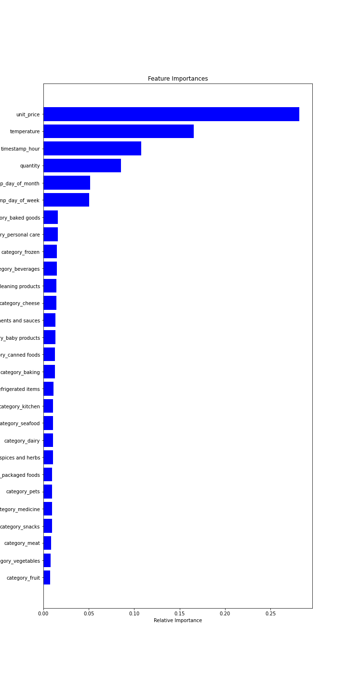
Stock Prediction model workflow
Feature Importance
Datasets provided by the client
Implemented data exploration, data cleaning & data merging
Used feature engineering & k-fold cross validation
‘Random Forest Regressor’ Model used for prediction
Scaled the data and computed accuracy using mean absolute error (MAE)
Model is predicting robustly
Due to small samples of data, value of MAE is large (accuracy as a percentage was around 50%)
Feature importance is Utilized, found that:
‘product categories’ were insignificant
‘unit price’ and ‘temperature’ were crucial in predicting stock
‘hour of day’ was also important for predicting stock

